Slide 1
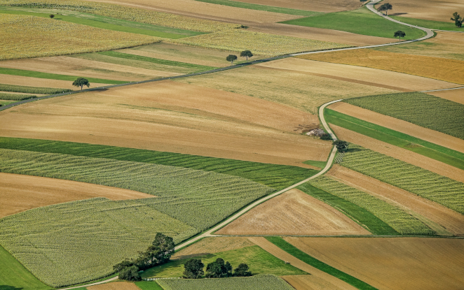


PRESENTATION ON
Development of QGIS Plugin for
Land Records Information System
Presented By:
PRIYANSHI PAL
ABMCS21004
2142514
MSc Computer Science
Under the supervision of:
DR. GANESH KHADANGA
Sr. Technical Director (Scientist – F)

Slide 2
CONTENTS
PROBLEM STATEMENT
Traditional method of maintaining land record system suffer from following disadvantage
Outdated records.
Lack of efficiency
Lack of Accessibility
Lack of accuracy
Prone to fraud
There is a critical need for a modernized digital solution to ensure the uniqueness, transparency, and up-to-date maintenance of land records.

Slide 3
3 PHASES OF PROJECT
1.
Image Segmentation and Boundary Detection
2.
Plugin Development for Land Record System
3.
Quantum Computing and Image Processing
PRESENTATION ON
Development of QGIS Plugin for
Land Records Information System
Presented By:
PRIYANSHI PAL
ABMCS21004
2142514
MSc Computer Science
Under the supervision of:
DR. GANESH KHADANGA
Sr. Technical Director (Scientist – F)

Slide 4

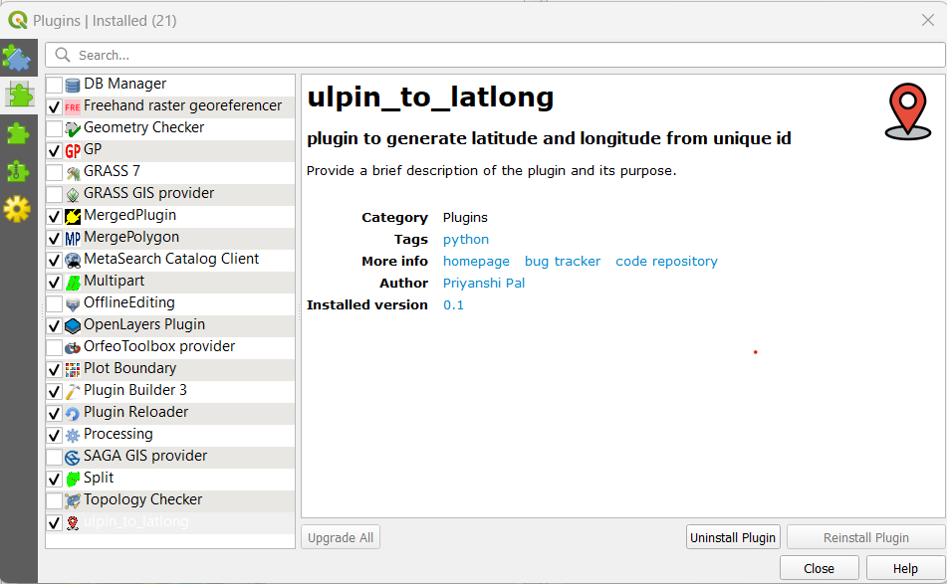
1
WHAT ARE PLUGINS?
CONTENTS
Used to add or extend functionalities
Tailor user specific needs
External and User Defined
Built in python /C++
User Designed
Growth
2
PLUGINS CREATION
3
DESIGNED PLUGINS
4
WORKING OF SPLIT
Fig 1: Manage and Install Plugins
5
WORKING OF MERGE PLUGIN
6
H/W & S/W REQUIREMENT
7
DATA FLOW DIAGRAM
8
USE CASE DIAGRAM
9
DATABASE DIAGRAM
10
LAND RECORD SYSTEM
11
FUTURE SCOPE
12
REFERENCES

Slide 5

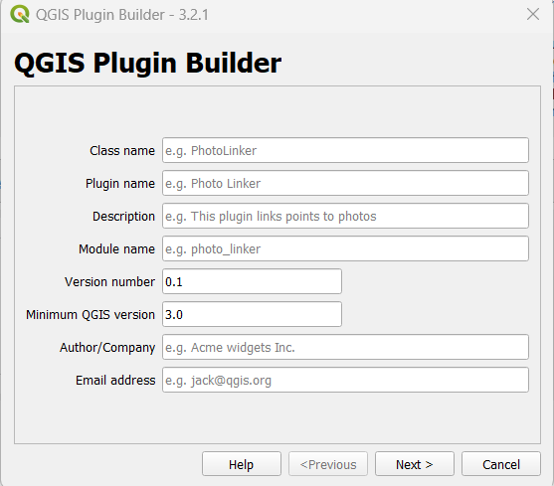
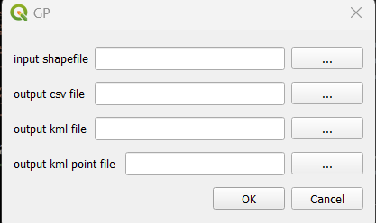
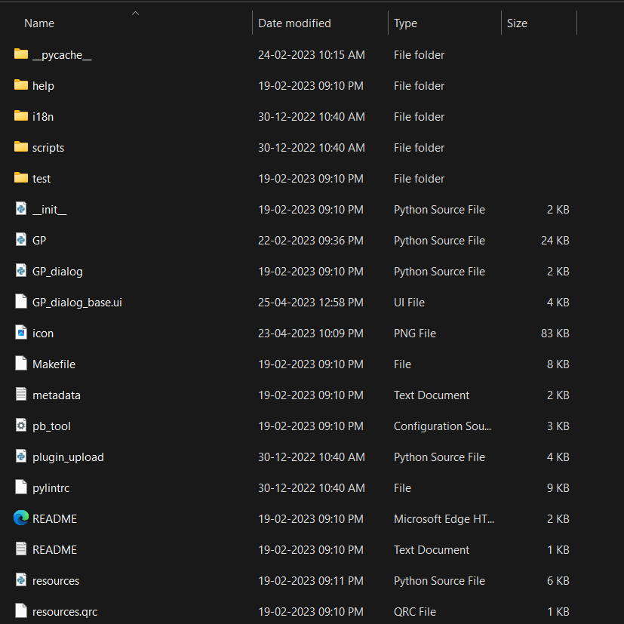
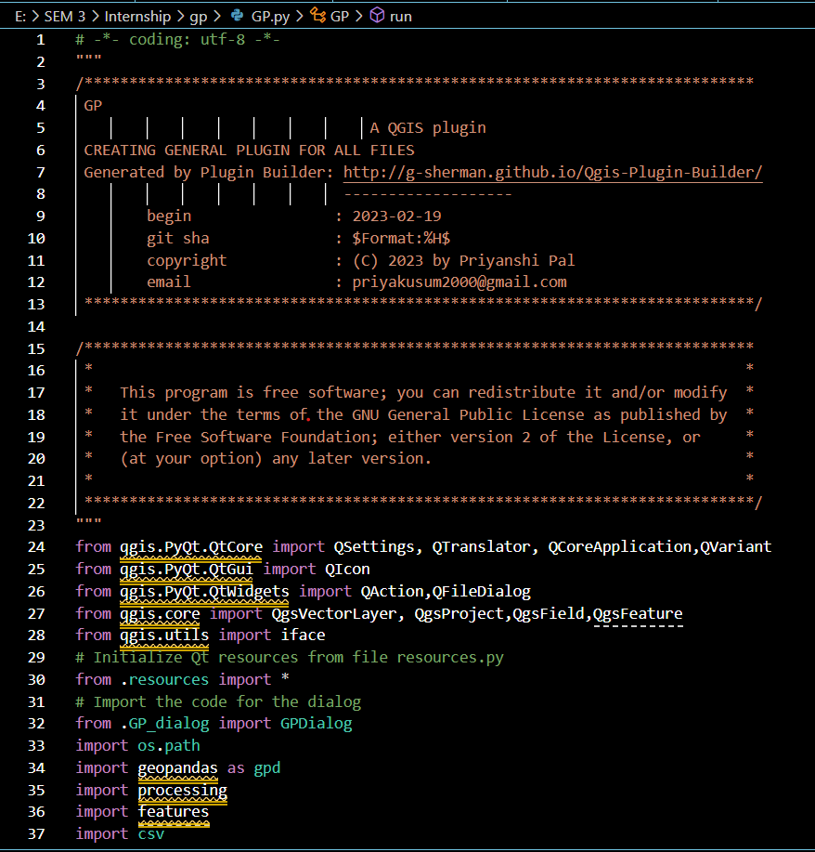
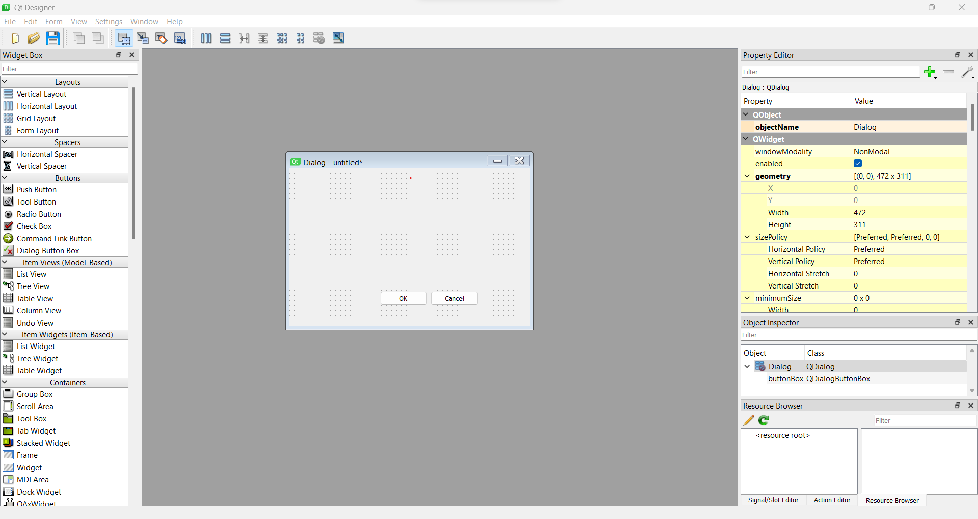
CONTENTS
2
PLUGINS CREATION
1
WHAT ARE PLUGINS?
3
DESIGNED PLUGINS
4
WORKING OF SPLIT
5
WORKING OF MERGE PLUGIN
Fig 2: Plugin Builder
Fig 6: Plugins
7
DATA FLOW DIAGRAM
8
USE CASE DIAGRAM
9
DATABASE DIAGRAM
11
FUTURE SCOPE
12
REFERENCES
Fig 3: Qt Designer
Fig 5: Files Generated
Fig 4: Python File
6
H/W & S/W REQUIREMENT
10
LAND RECORD SYSTEM

Slide 6
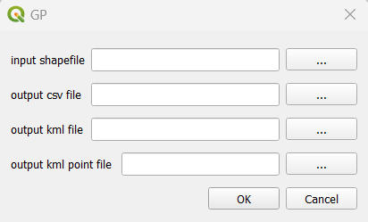
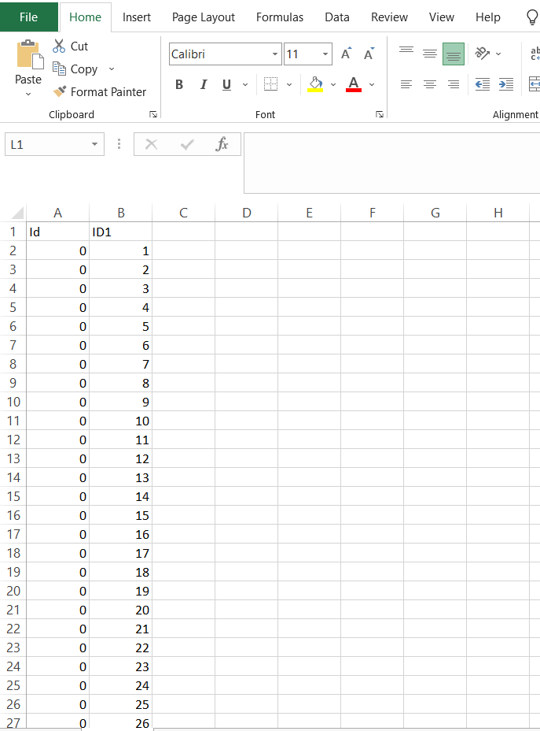

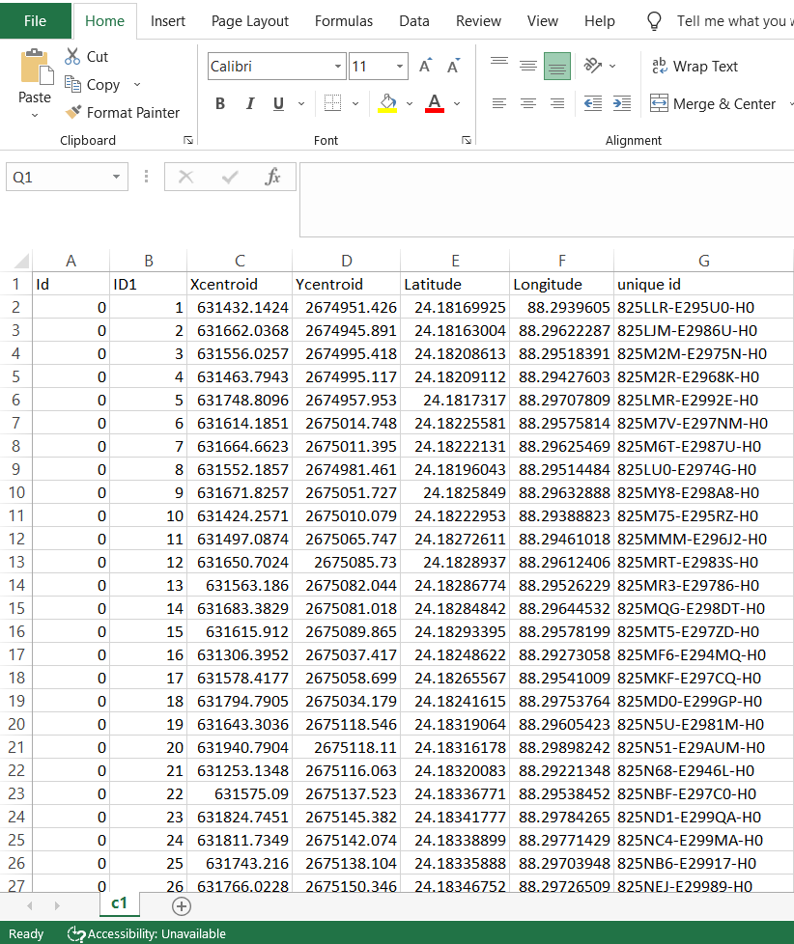
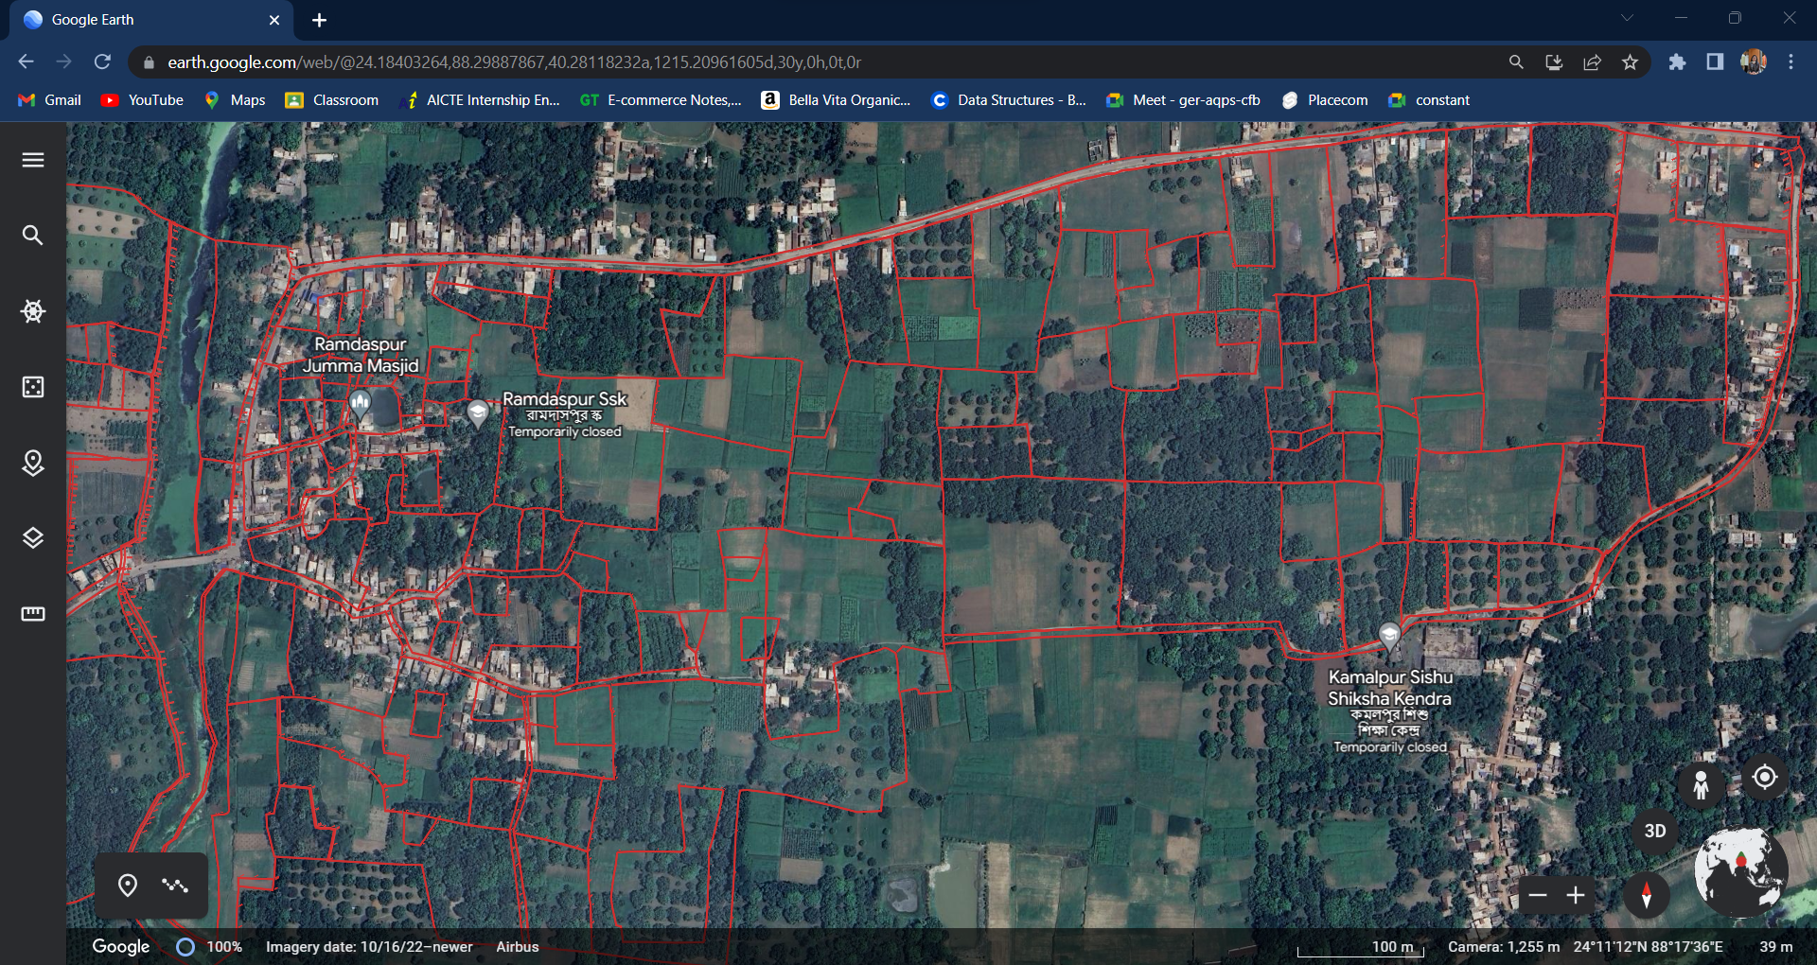
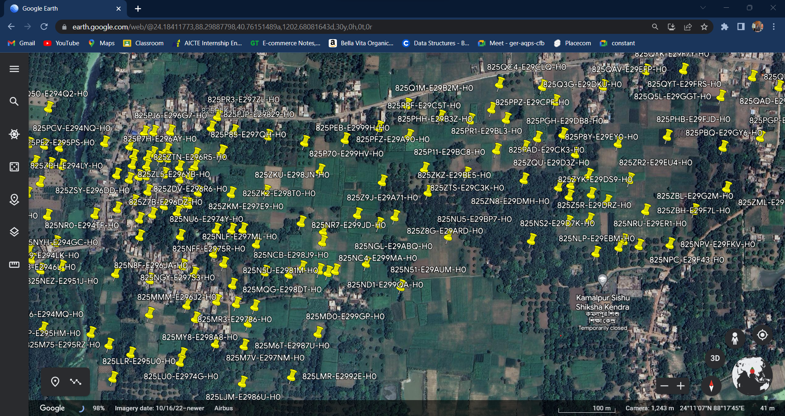
CONTENTS
3
DESIGNED PLUGINS
1
WHAT ARE PLUGINS?
2
PLUGINS CREATION
4
WORKING OF SPLIT
5
WORKING OF MERGE PLUGIN
6
H/W & S/W REQUIREMENT
Fig 6: Generating Points
8
USE CASE DIAGRAM
Fig 7: Original Shapefile
9
DATABASE DIAGRAM
10
LAND RECORD SYSTEM
12
REFERENCES
Fig 9: KML Boundary File
Fig 8: CSV File
Fig 10: KML Point File
7
DATA FLOW DIAGRAM
11
FUTURE SCOPE

Slide 7
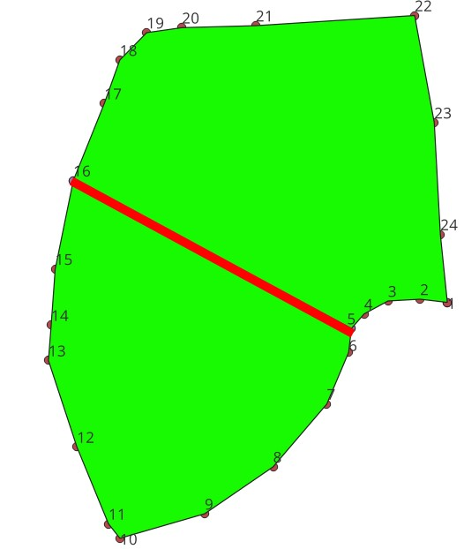
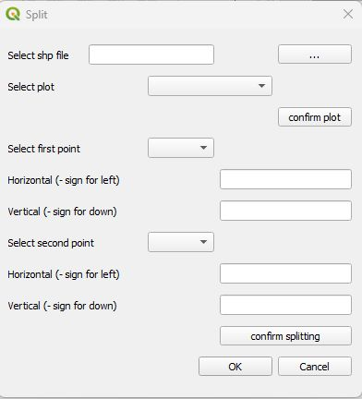


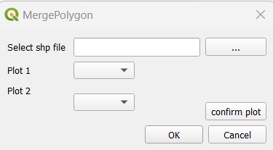
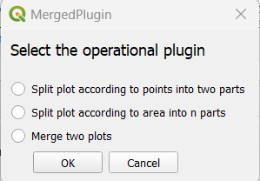
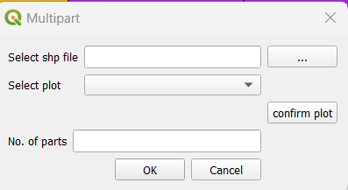
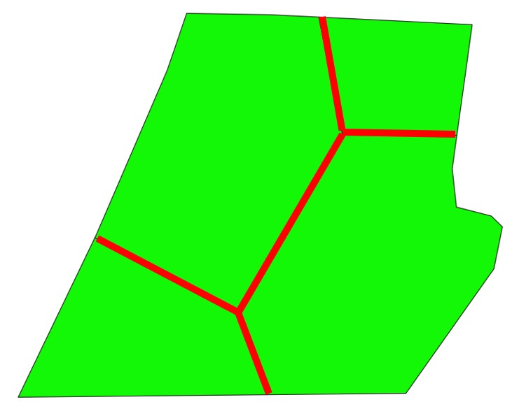
CONTENTS
3
DESIGNED PLUGINS
1
WHAT ARE PLUGINS?
2
PLUGINS CREATION
4
WORKING OF SPLIT
5
WORKING OF MERGE PLUGIN
6
H/W & S/W REQUIREMENT
Fig 6: Generating Points
8
USE CASE DIAGRAM
Fig 7: Original Shapefile
Fig 12: Merge Two Plots
Fig 11: Merge Plugin
9
DATABASE DIAGRAM
10
LAND RECORD SYSTEM
12
REFERENCES
Fig 13: Split Into N Parts
Fig 14: Split Into Two Parts
Fig 9: KML Boundary File
Fig 8: CSV File
Fig 10: KML Point File
7
DATA FLOW DIAGRAM
11
FUTURE SCOPE

Slide 8
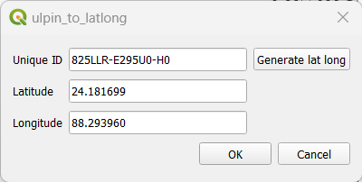
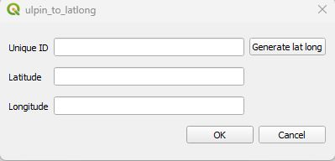

CONTENTS
3
DESIGNED PLUGINS
1
WHAT ARE PLUGINS?
2
PLUGINS CREATION
4
WORKING OF SPLIT
5
WORKING OF MERGE PLUGIN
6
H/W & S/W REQUIREMENT
Fig 6: Generating Points
8
USE CASE DIAGRAM
Fig 7: Original Shapefile
Fig 15 :Unique Id Of Plots To Latitude & Longitude
Fig 12: Merge Two Plots
Fig 16 : Generating Output
Fig 11: Merge Plugin
9
DATABASE DIAGRAM
10
LAND RECORD SYSTEM
12
REFERENCES
Fig 17: Details of Latitude , Longitude and Unique ID
Fig 13: Split Into N Parts
Fig 14: Split Into Two Parts
Fig 9: KML Boundary File
Fig 8: CSV File
Fig 10: KML Point File
7
DATA FLOW DIAGRAM
11
FUTURE SCOPE

Slide 9
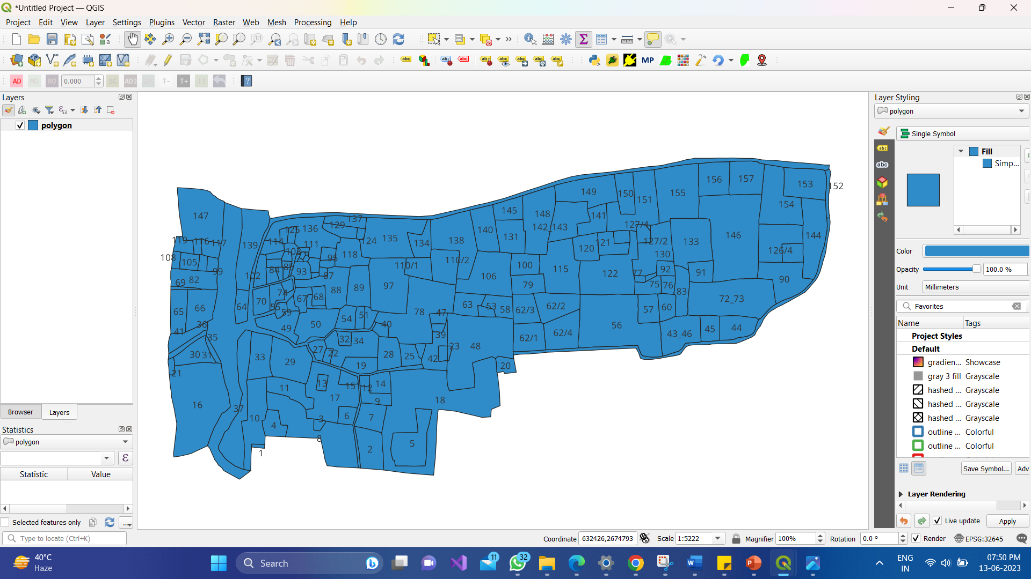
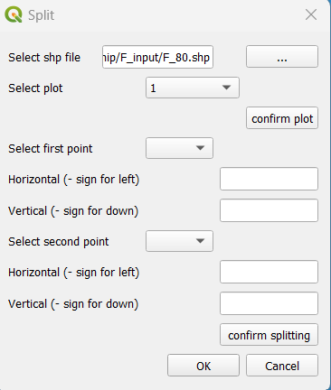
CONTENTS
4
WORKING OF SPLIT
Fig 18: Display
Fig 19: Input
1
WHAT ARE PLUGINS?
2
PLUGINS CREATION
3
DESIGNED PLUGINS
5
WORKING OF MERGE PLUGIN
6
H/W & S/W REQUIREMENT
7
DATA FLOW DIAGRAM
8
USE CASE DIAGRAM
9
DATABASE DIAGRAM
10
LAND RECORD SYSTEM
11
FUTURE SCOPE
12
REFERENCES

Slide 10
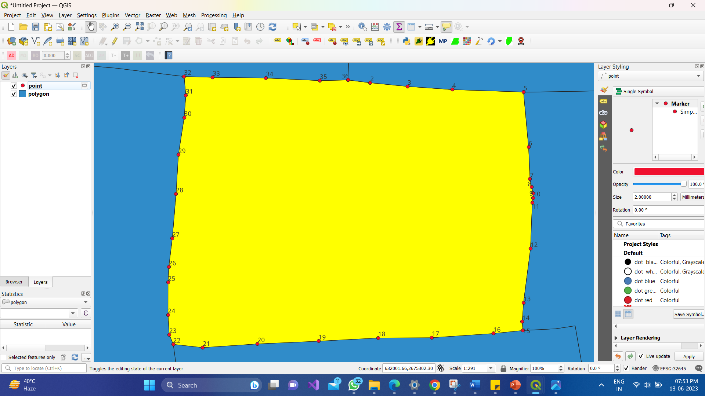
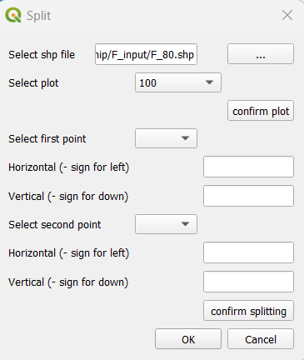
CONTENTS
4
WORKING OF SPLIT
Fig 18: Display
Fig 19: Input
1
WHAT ARE PLUGINS?
2
PLUGINS CREATION
3
DESIGNED PLUGINS
5
WORKING OF MERGE PLUGIN
6
H/W & S/W REQUIREMENT
7
DATA FLOW DIAGRAM
8
USE CASE DIAGRAM
9
DATABASE DIAGRAM
10
LAND RECORD SYSTEM
11
FUTURE SCOPE
12
REFERENCES

Slide 11
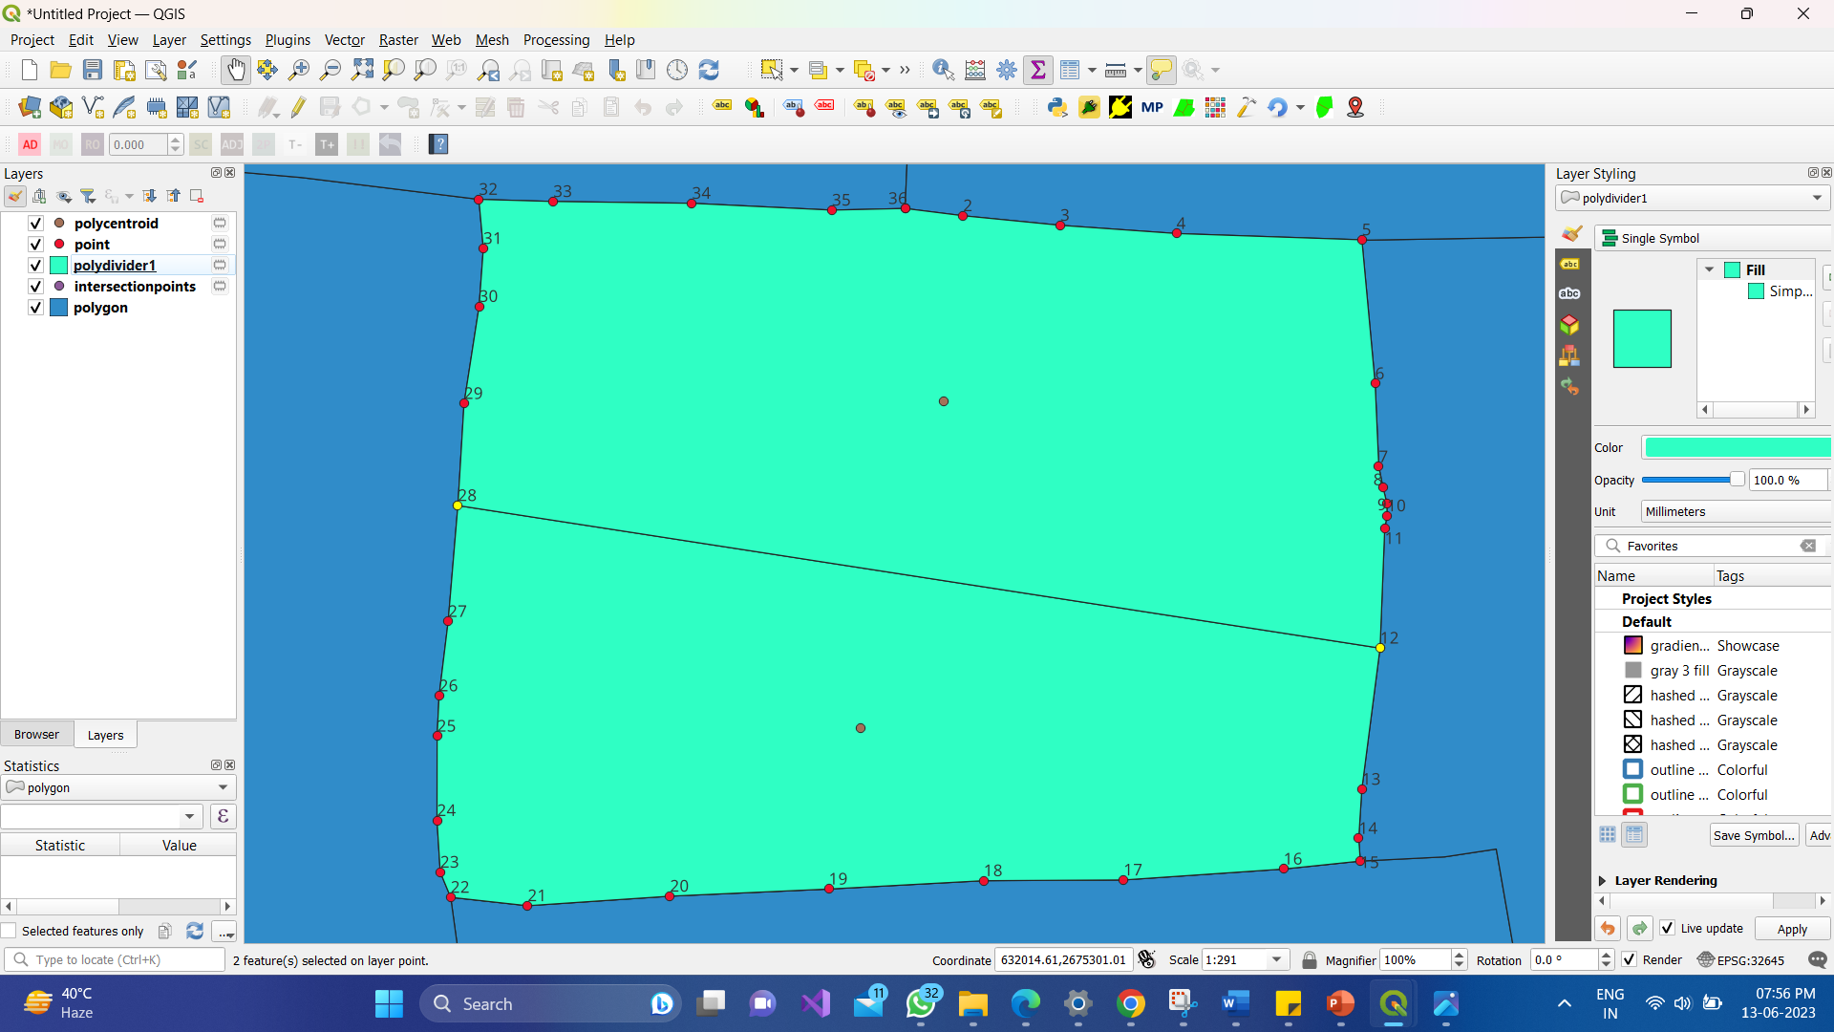
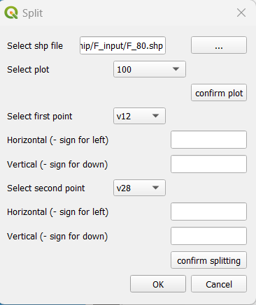
CONTENTS
4
WORKING OF SPLIT
Fig 18: Display
Fig 19: Input
1
WHAT ARE PLUGINS?
2
PLUGINS CREATION
3
DESIGNED PLUGINS
5
WORKING OF MERGE PLUGIN
6
H/W & S/W REQUIREMENT
7
DATA FLOW DIAGRAM
8
USE CASE DIAGRAM
9
DATABASE DIAGRAM
10
LAND RECORD SYSTEM
11
FUTURE SCOPE
12
REFERENCES

Slide 12
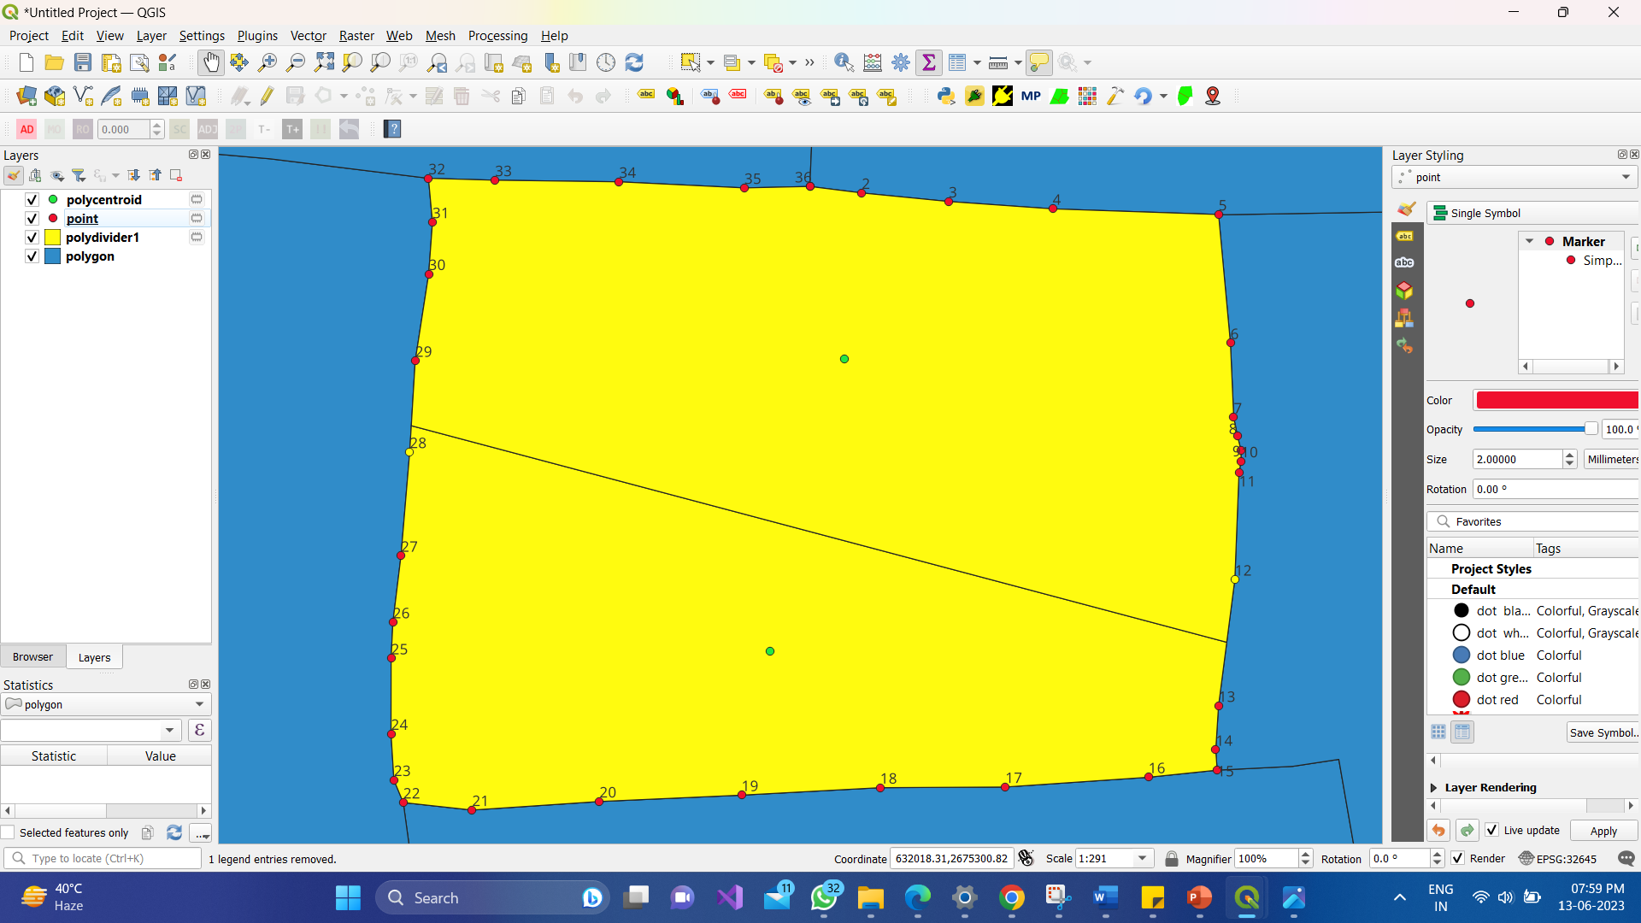
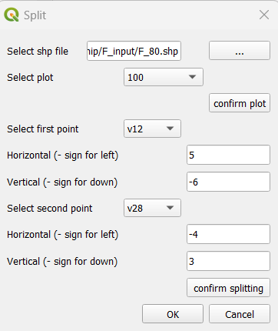
CONTENTS
4
WORKING OF SPLIT
Fig 18: Display
Fig 19: Input
1
WHAT ARE PLUGINS?
2
PLUGINS CREATION
3
DESIGNED PLUGINS
5
WORKING OF MERGE PLUGIN
6
H/W & S/W REQUIREMENT
7
DATA FLOW DIAGRAM
8
USE CASE DIAGRAM
9
DATABASE DIAGRAM
10
LAND RECORD SYSTEM
11
FUTURE SCOPE
12
REFERENCES

Slide 13
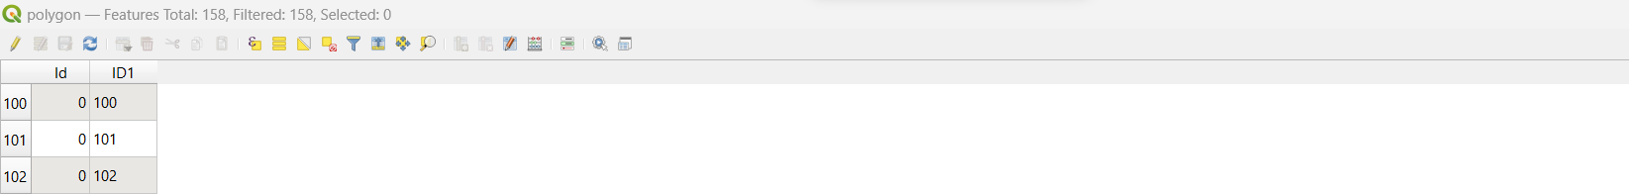
CONTENTS
4
WORKING OF SPLIT
Original Shapefile
Unique Point Generation
Splitting Result
Fig 18: Display
Fig 19: Input
1
WHAT ARE PLUGINS?
2
PLUGINS CREATION
3
DESIGNED PLUGINS
5
WORKING OF MERGE PLUGIN
6
H/W & S/W REQUIREMENT
7
DATA FLOW DIAGRAM
8
USE CASE DIAGRAM
9
DATABASE DIAGRAM
10
LAND RECORD SYSTEM
11
FUTURE SCOPE
12
REFERENCES

Slide 14
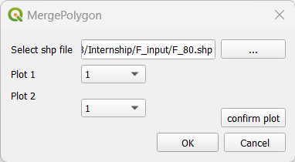
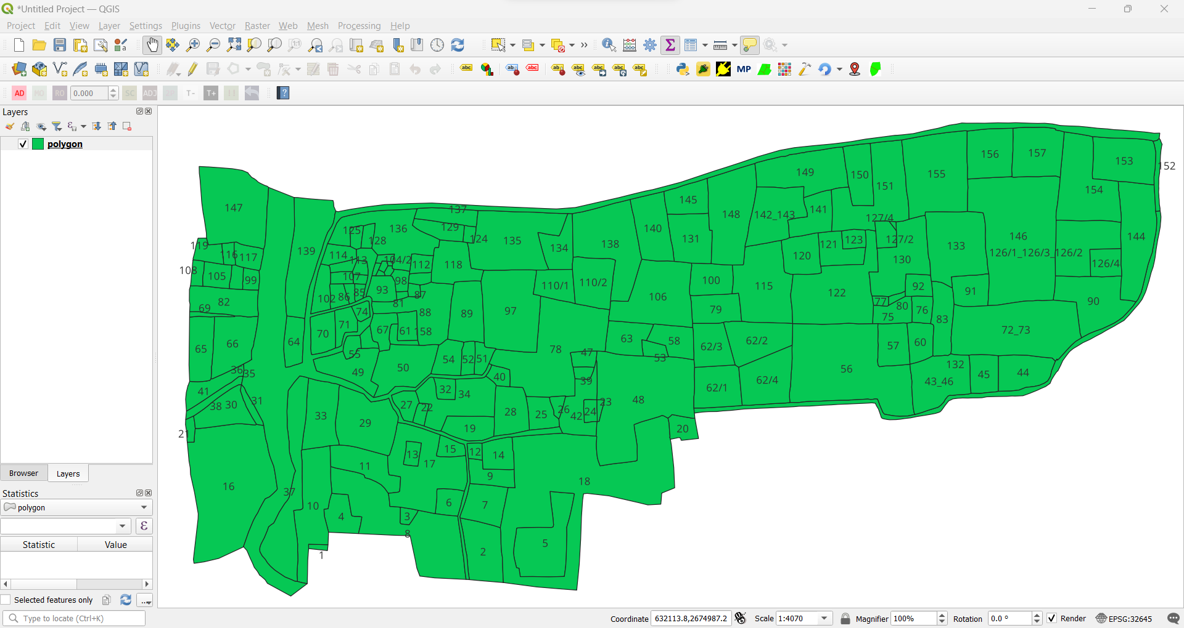
CONTENTS
1
WHAT ARE PLUGINS?
5
WORKING OF MERGE PLUGIN
2
PLUGINS CREATION
3
DESIGNED PLUGINS
4
WORKING OF SPLIT
Fig 20: Input
6
H/W & S/W REQUIREMENT
7
DATA FLOW DIAGRAM
8
USE CASE DIAGRAM
Fig 21: Display
10
LAND RECORD SYSTEM
11
FUTURE SCOPE
12
REFERENCES
9
DATABASE DIAGRAM

Slide 15
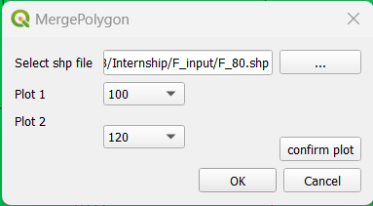
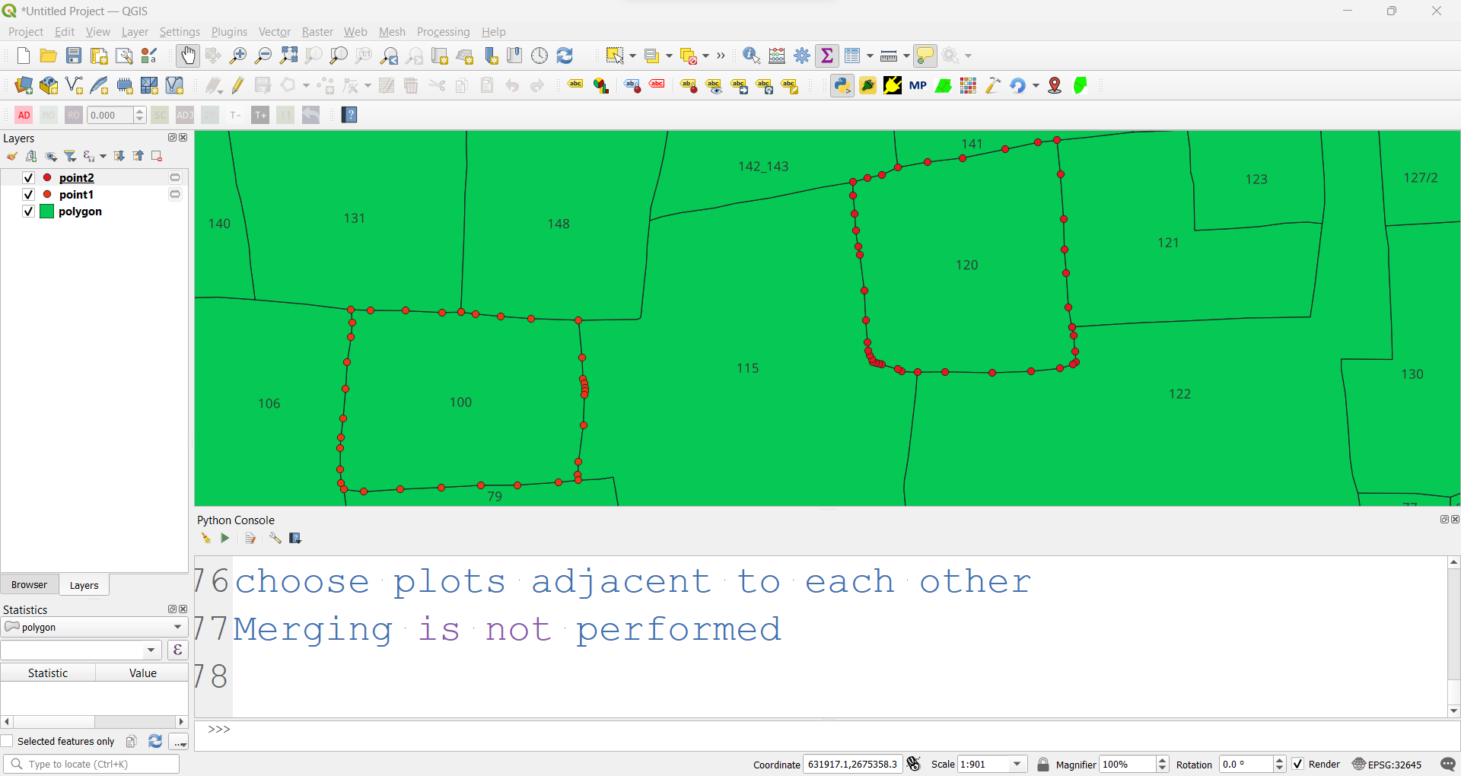
CONTENTS
1
WHAT ARE PLUGINS?
5
WORKING OF MERGE PLUGIN
2
PLUGINS CREATION
3
DESIGNED PLUGINS
4
WORKING OF SPLIT
Fig 20: Input
6
H/W & S/W REQUIREMENT
7
DATA FLOW DIAGRAM
8
USE CASE DIAGRAM
Fig 21: Display
10
LAND RECORD SYSTEM
11
FUTURE SCOPE
12
REFERENCES
9
DATABASE DIAGRAM

Slide 16
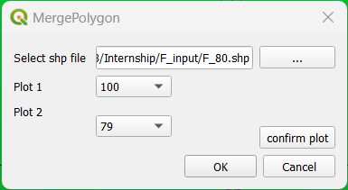
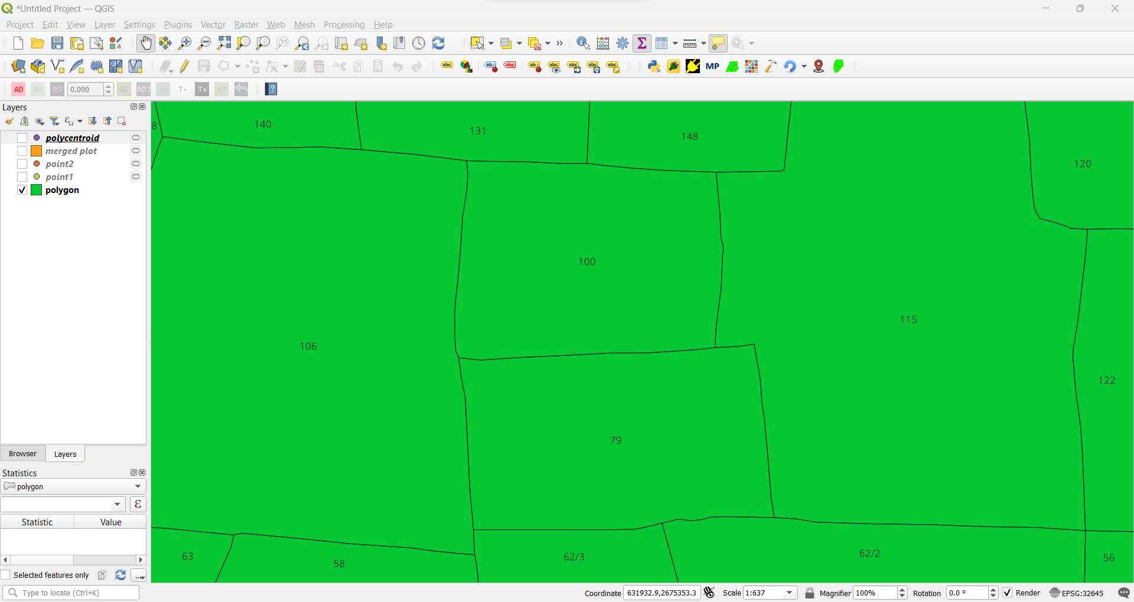
CONTENTS
1
WHAT ARE PLUGINS?
5
WORKING OF MERGE PLUGIN
2
PLUGINS CREATION
3
DESIGNED PLUGINS
4
WORKING OF SPLIT
Fig 20: Input
6
H/W & S/W REQUIREMENT
7
DATA FLOW DIAGRAM
8
USE CASE DIAGRAM
Fig 21: Display
10
LAND RECORD SYSTEM
11
FUTURE SCOPE
12
REFERENCES
9
DATABASE DIAGRAM

Slide 17
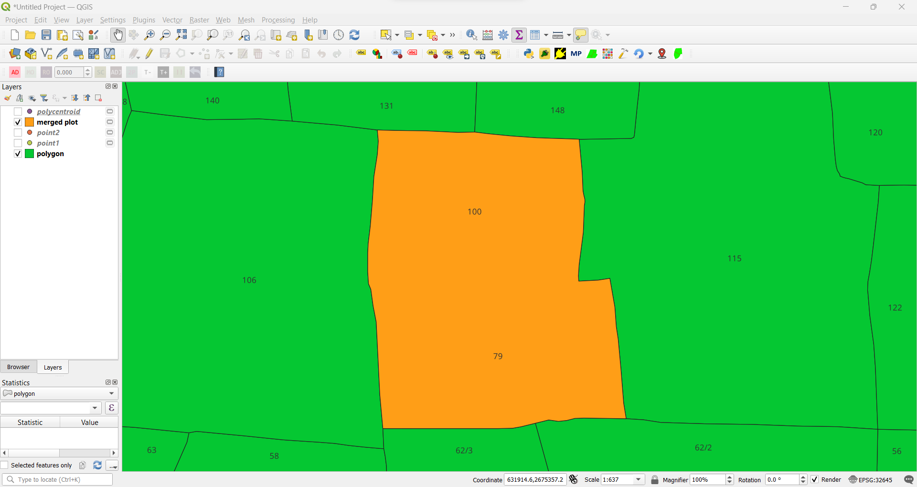
CONTENTS
1
WHAT ARE PLUGINS?
5
WORKING OF MERGE PLUGIN
2
PLUGINS CREATION
3
DESIGNED PLUGINS
4
WORKING OF SPLIT
Fig 20: Input
6
H/W & S/W REQUIREMENT
7
DATA FLOW DIAGRAM
8
USE CASE DIAGRAM
Fig 21: Display
10
LAND RECORD SYSTEM
11
FUTURE SCOPE
12
REFERENCES
9
DATABASE DIAGRAM

Slide 18
CONTENTS
1
WHAT ARE PLUGINS?
5
WORKING OF MERGE PLUGIN
2
PLUGINS CREATION
3
DESIGNED PLUGINS
4
WORKING OF SPLIT
Original Shapefile
Merging Result
Fig 20: Input
6
H/W & S/W REQUIREMENT
7
DATA FLOW DIAGRAM
8
USE CASE DIAGRAM
Fig 21: Display
10
LAND RECORD SYSTEM
11
FUTURE SCOPE
12
REFERENCES
9
DATABASE DIAGRAM

Slide 19





CONTENTS
2
PLUGINS CREATION
6
H/W & S/W REQUIREMENT
1
WHAT ARE PLUGINS?
3
DESIGNED PLUGINS
4
WORKING OF SPLIT
5
WORKING OF MERGE PLUGIN
H/W REQUIREMENTS
At least a 32-bit computer is required.
At least 4 Gb of RAM
Windows 7 or above should be installed.
Intel i4 core 1.3 GHz processor
S/W REQUIREMENTS
7
DATA FLOW DIAGRAM
8
USE CASE DIAGRAM
9
DATABASE DIAGRAM
11
FUTURE SCOPE
12
REFERENCES
Fig 22: QGIS
Fig 23: Qt Designer
Fig 24: OS Geo4Shell
Fig 25: XAMPP
Fig 26: Postgres SQL Database
10
LAND RECORD SYSTEM

Slide 20
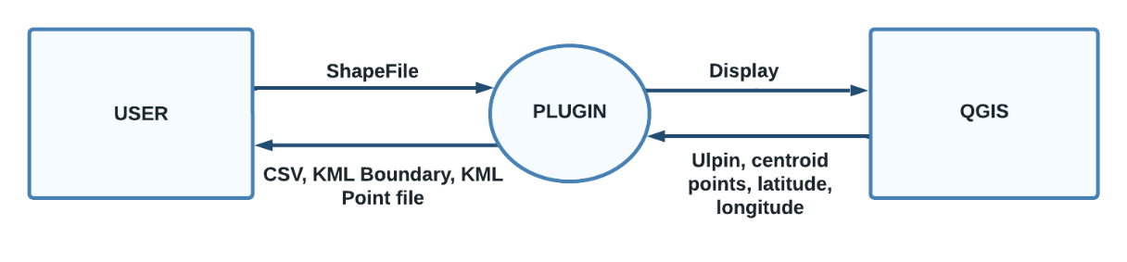
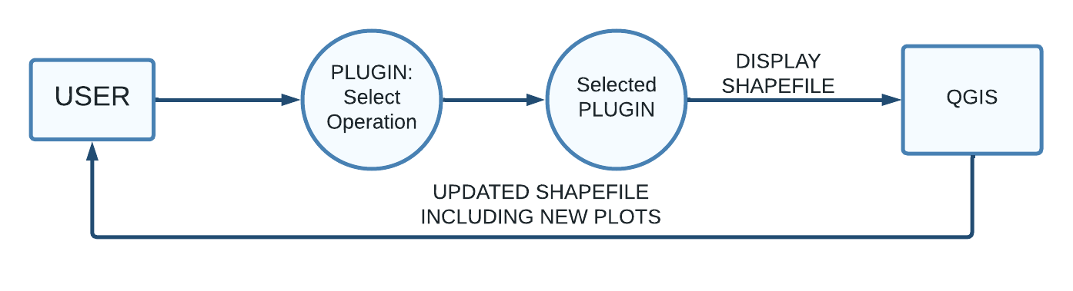
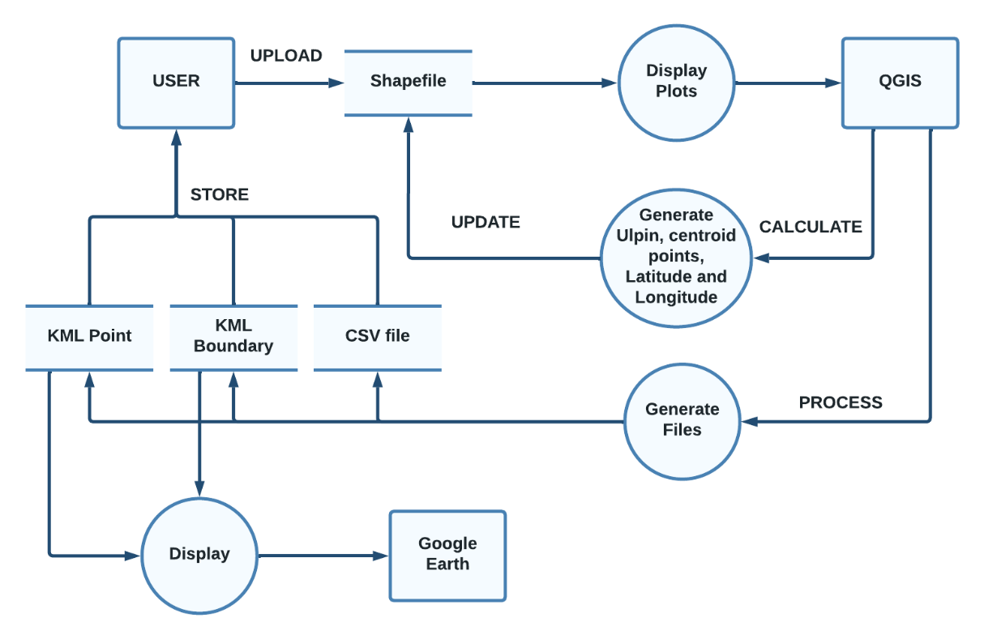
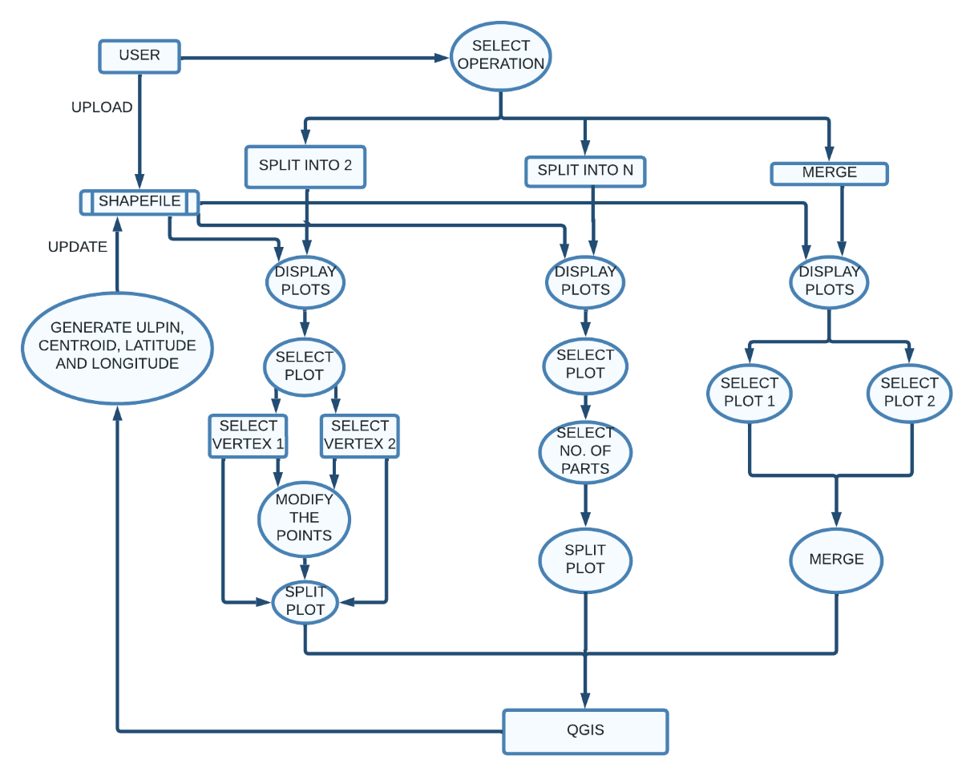
CONTENTS
3
DESIGNED PLUGINS
7
DATA FLOW DIAGRAM
1
WHAT ARE PLUGINS?
GP (Generating Point)
Merge Plugin
2
PLUGINS CREATION
4
WORKING OF SPLIT
5
WORKING OF MERGE PLUGIN
Fig 27: Level-0
Fig 29: Level-0
8
USE CASE DIAGRAM
6
H/W & S/W REQUIREMENT
9
DATABASE DIAGRAM
10
LAND RECORD SYSTEM
12
REFERENCES
Fig 28: Level-1
Fig 30: Level-1
11
FUTURE SCOPE

Slide 21
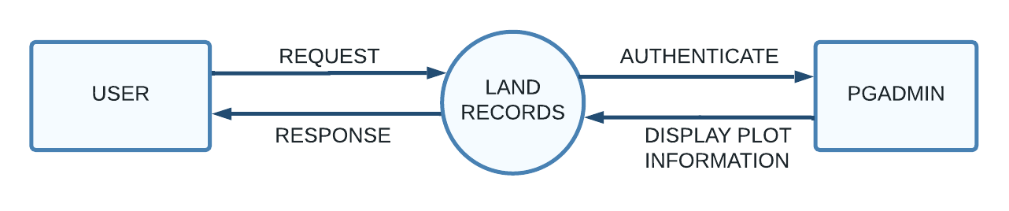
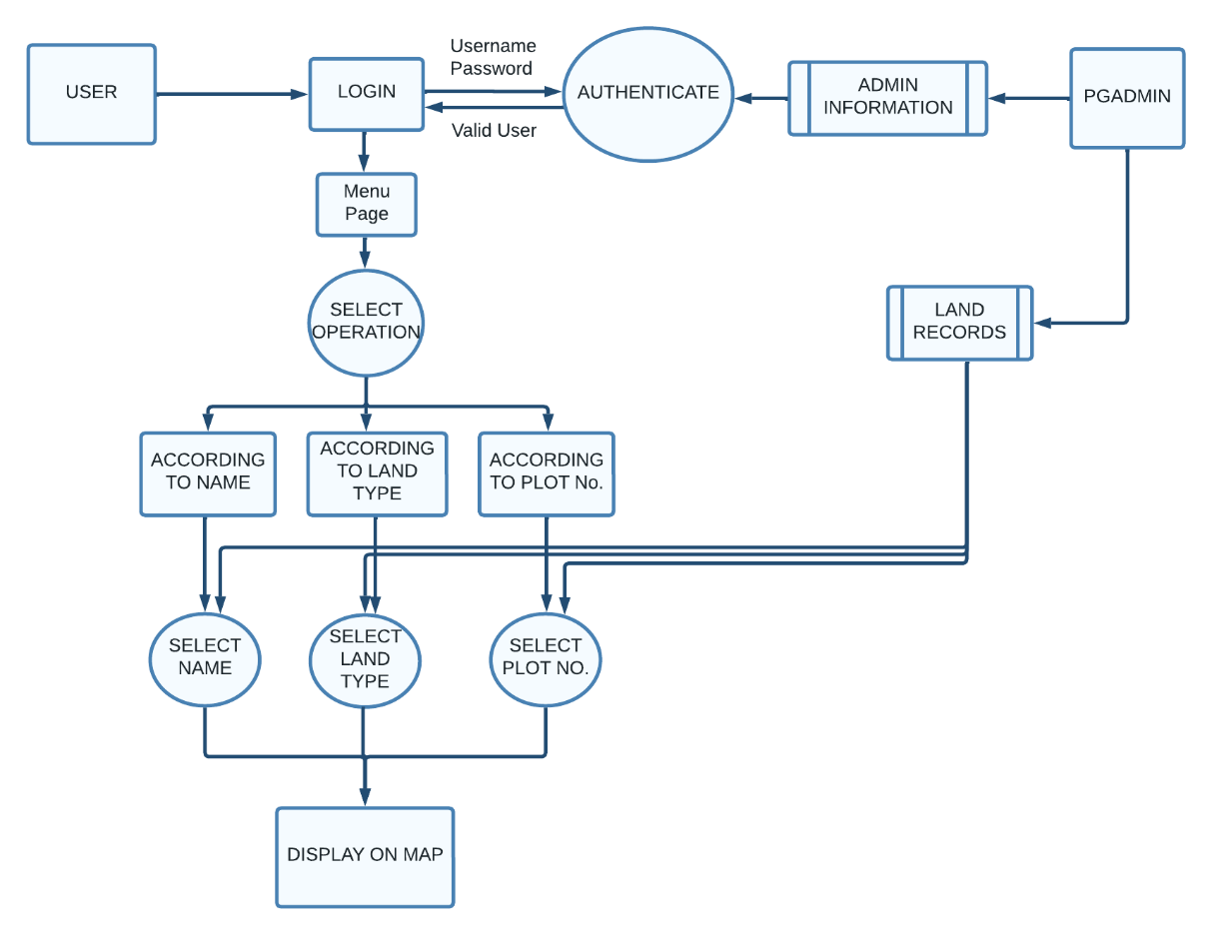
CONTENTS
3
DESIGNED PLUGINS
7
DATA FLOW DIAGRAM
1
WHAT ARE PLUGINS?
2
PLUGINS CREATION
4
WORKING OF SPLIT
Land Record System
Fig 31: Level-0
5
WORKING OF MERGE PLUGIN
6
H/W & S/W REQUIREMENT
8
USE CASE DIAGRAM
9
DATABASE DIAGRAM
10
LAND RECORD SYSTEM
12
REFERENCES
Fig 32: Level-1
11
FUTURE SCOPE

Slide 22
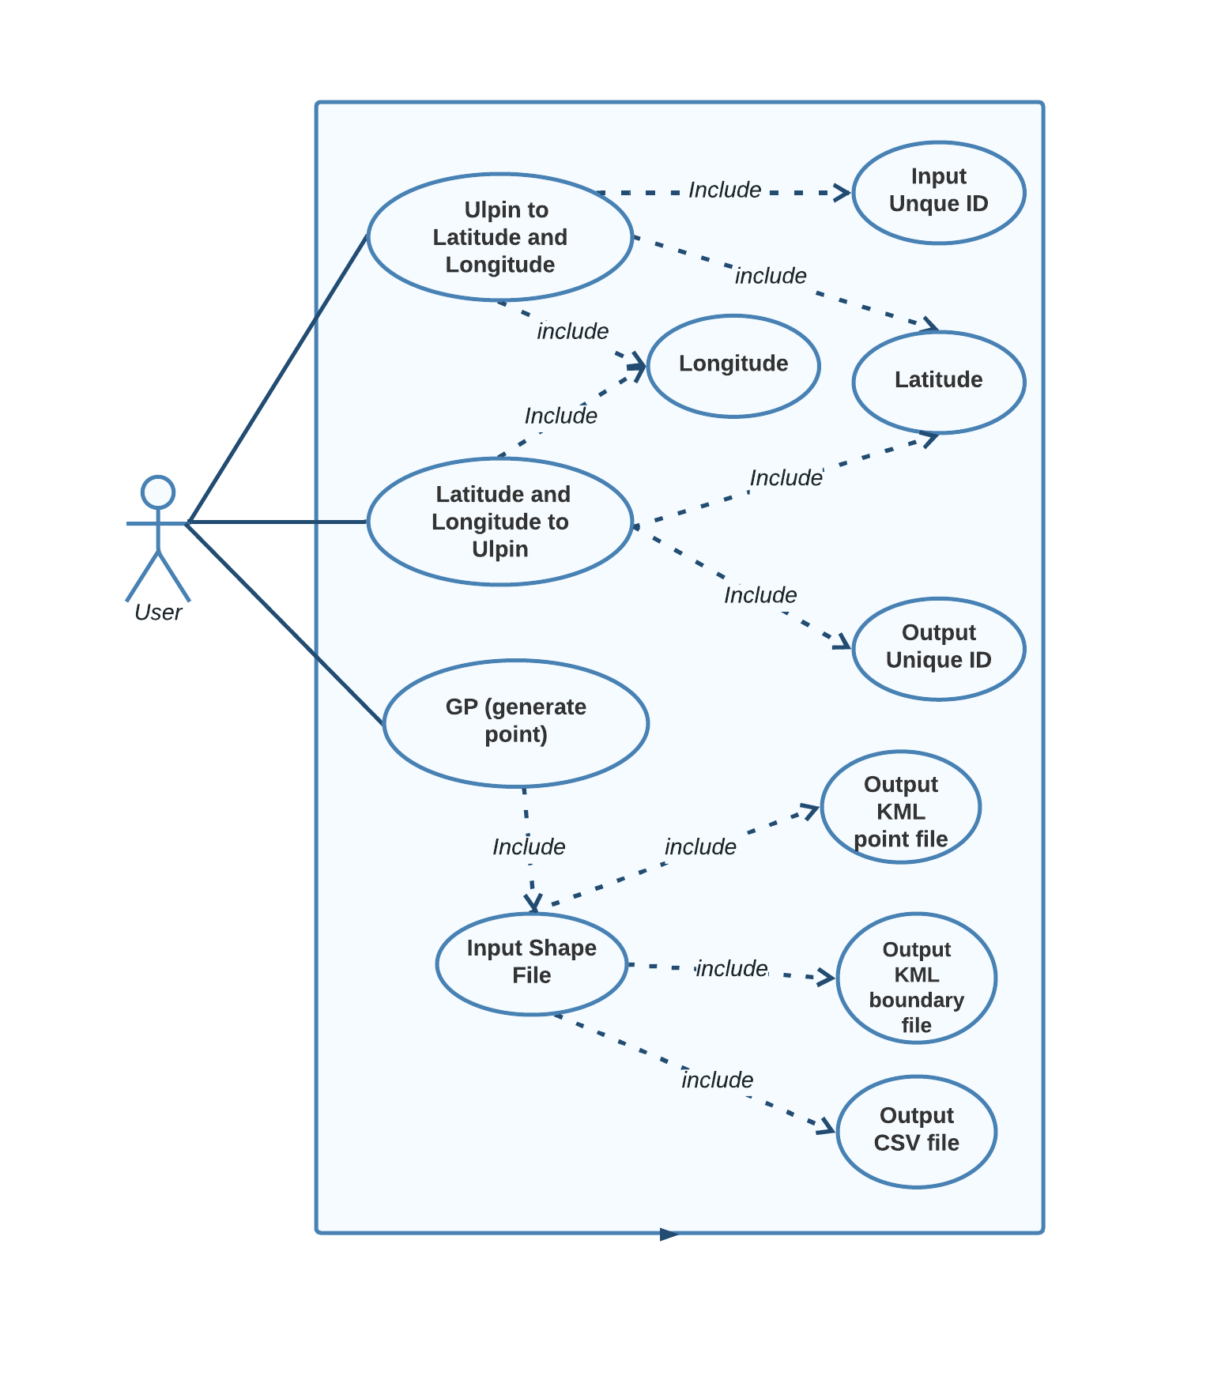
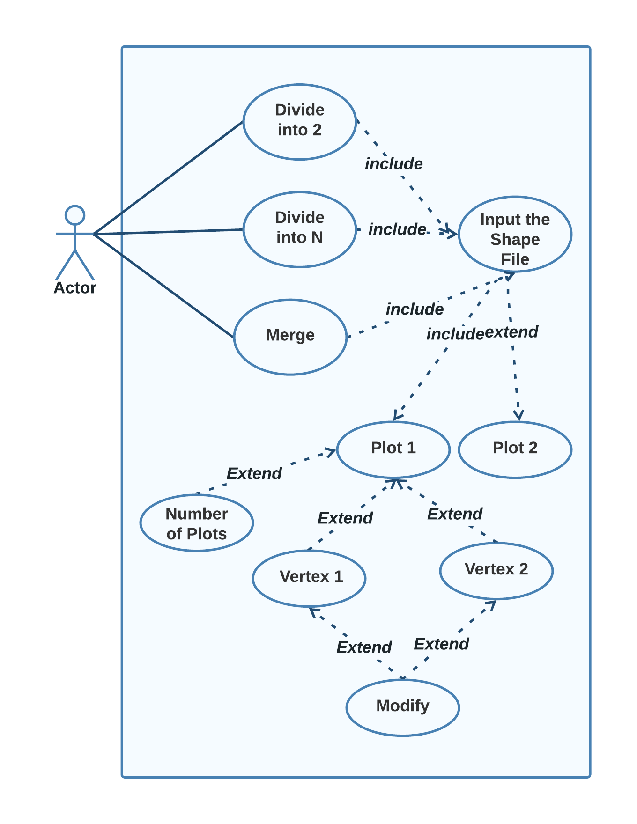
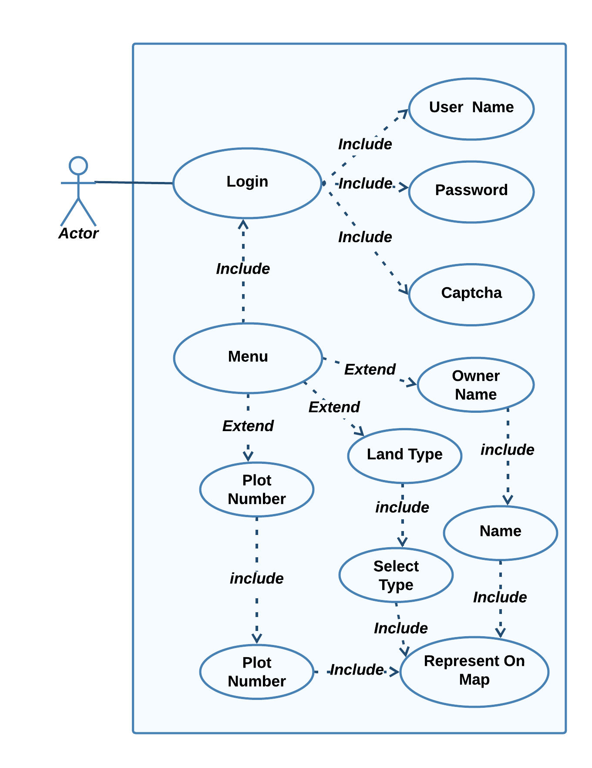
CONTENTS
4
WORKING OF SPLIT
8
USE CASE DIAGRAM
1
WHAT ARE PLUGINS?
2
PLUGINS CREATION
3
DESIGNED PLUGINS
5
WORKING OF MERGE PLUGIN
6
H/W & S/W REQUIREMENT
7
DATA FLOW DIAGRAM
9
DATABASE DIAGRAM
10
LAND RECORD SYSTEM
11
FUTURE SCOPE
Fig 33: GP (Generating Point)
Fig 34: Merge Plugin
Fig 35: Land Record System
12
REFERENCES

Slide 23
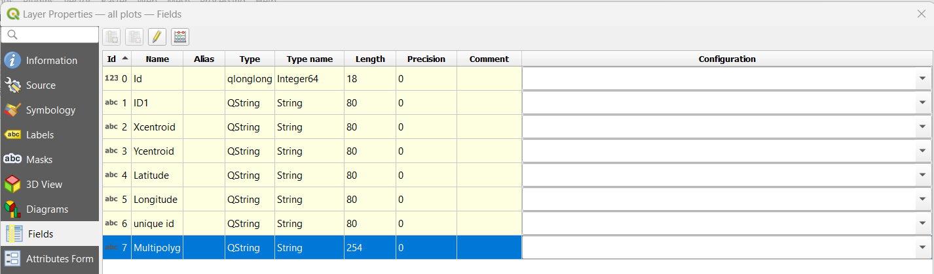
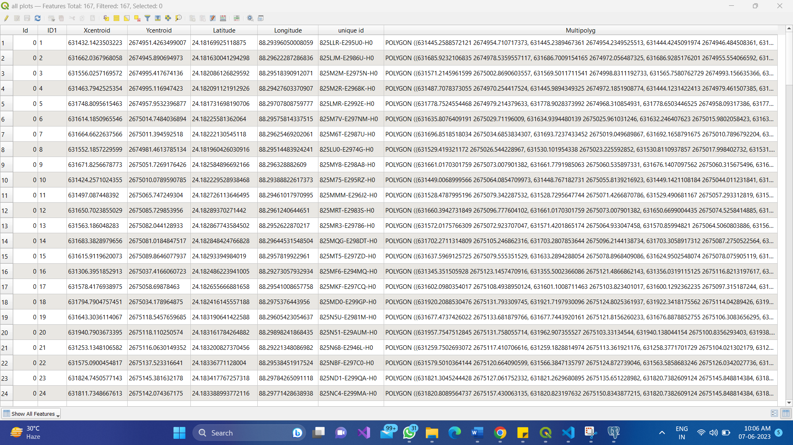
CONTENTS
1
WHAT ARE PLUGINS?
2
PLUGINS CREATION
3
DESIGNED PLUGINS
4
WORKING OF SPLIT
5
WORKING OF MERGE PLUGIN
6
H/W & S/W REQUIREMENT
7
DATA FLOW DIAGRAM
8
USE CASE DIAGRAM
10
LAND RECORD SYSTEM
11
FUTURE SCOPE
12
REFERENCES
9
DATABASE DIAGRAM
Fig 36: Shape File Database
Fig 37: Attribute Table

Slide 24
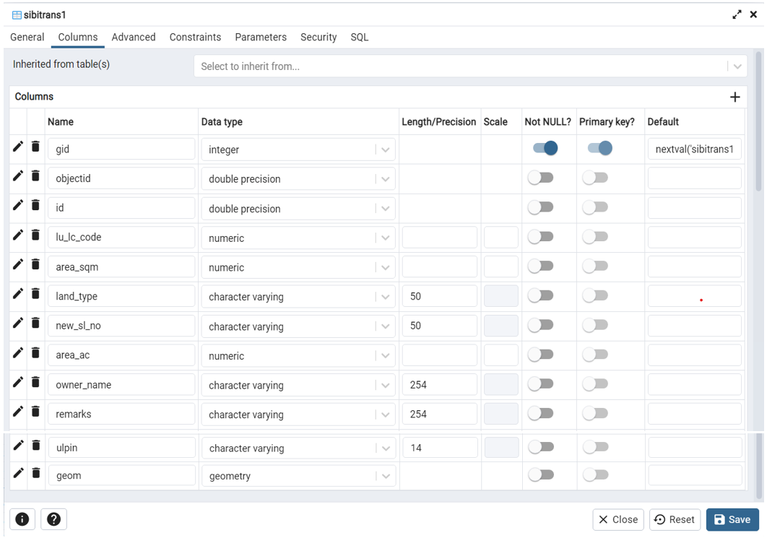
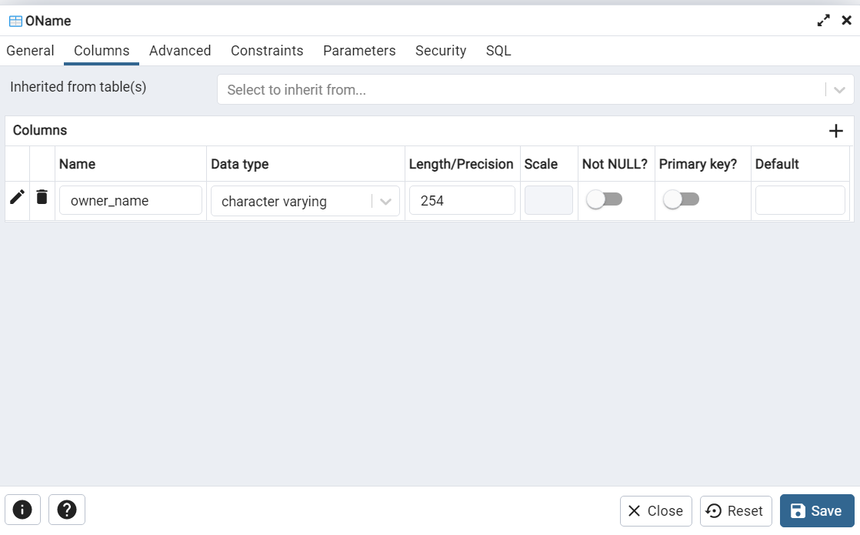
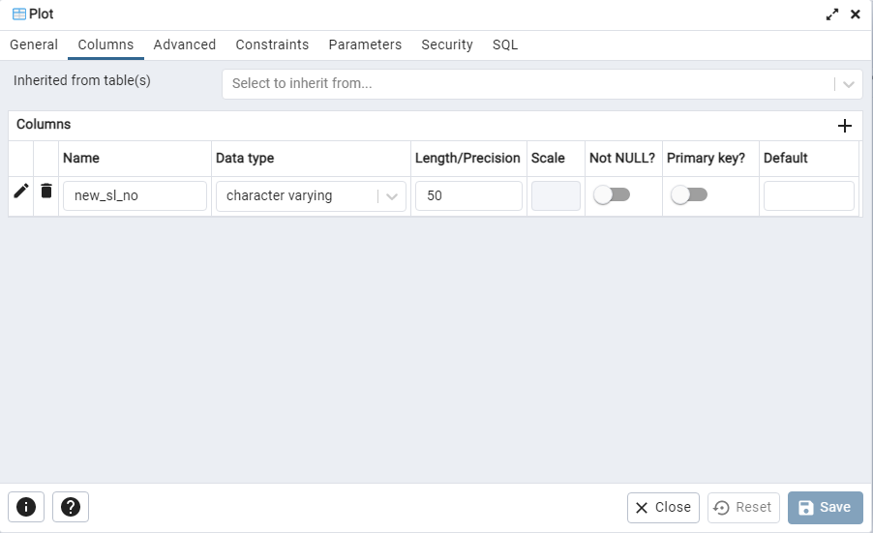

CONTENTS
1
WHAT ARE PLUGINS?
2
PLUGINS CREATION
3
DESIGNED PLUGINS
4
WORKING OF SPLIT
5
WORKING OF MERGE PLUGIN
6
H/W & S/W REQUIREMENT
7
DATA FLOW DIAGRAM
8
USE CASE DIAGRAM
10
LAND RECORD SYSTEM
11
FUTURE SCOPE
12
REFERENCES
9
DATABASE DIAGRAM
Fig 39: Intermediate Table OName
Fig 40: Intermediate Table Plot
Fig 38: Original Data Table -Sibitrans1
Fig 41: Intermediate Table LType

Slide 25

CONTENTS
2
PLUGINS CREATION
6
H/W & S/W REQUIREMENT
10
LAND RECORD SYSTEM
1
WHAT ARE PLUGINS?
3
DESIGNED PLUGINS
4
WORKING OF SPLIT
5
WORKING OF MERGE PLUGIN
7
DATA FLOW DIAGRAM
8
USE CASE DIAGRAM
9
DATABASE DIAGRAM
11
FUTURE SCOPE
12
REFERENCES
Fig 42: Login Page

Slide 26

CONTENTS
2
PLUGINS CREATION
6
H/W & S/W REQUIREMENT
10
LAND RECORD SYSTEM
1
WHAT ARE PLUGINS?
3
DESIGNED PLUGINS
4
WORKING OF SPLIT
5
WORKING OF MERGE PLUGIN
7
DATA FLOW DIAGRAM
8
USE CASE DIAGRAM
9
DATABASE DIAGRAM
11
FUTURE SCOPE
12
REFERENCES
Fig 42: Login Page
Fig 43: Menu Page

Slide 27

CONTENTS
2
PLUGINS CREATION
6
H/W & S/W REQUIREMENT
10
LAND RECORD SYSTEM
1
WHAT ARE PLUGINS?
3
DESIGNED PLUGINS
4
WORKING OF SPLIT
5
WORKING OF MERGE PLUGIN
7
DATA FLOW DIAGRAM
8
USE CASE DIAGRAM
9
DATABASE DIAGRAM
11
FUTURE SCOPE
12
REFERENCES
Fig 44: Entity Selection Page
Fig 42: Login Page
Fig 43: Menu Page

Slide 28

CONTENTS
2
PLUGINS CREATION
6
H/W & S/W REQUIREMENT
10
LAND RECORD SYSTEM
1
WHAT ARE PLUGINS?
3
DESIGNED PLUGINS
4
WORKING OF SPLIT
5
WORKING OF MERGE PLUGIN
7
DATA FLOW DIAGRAM
8
USE CASE DIAGRAM
9
DATABASE DIAGRAM
11
FUTURE SCOPE
12
REFERENCES
Fig 44: Entity Selection Page
Fig 42: Login Page
Fig 43: Menu Page
Fig 45: Display Map

Slide 29


CONTENTS
3
DESIGNED PLUGINS
7
DATA FLOW DIAGRAM
11
FUTURE SCOPE
1
WHAT ARE PLUGINS?
2
PLUGINS CREATION
4
WORKING OF SPLIT
Expansion to More States
Integration with Advanced Technologies
Mobile Application Development
5
WORKING OF MERGE PLUGIN
6
H/W & S/W REQUIREMENT
8
USE CASE DIAGRAM
9
DATABASE DIAGRAM
10
LAND RECORD SYSTEM
12
REFERENCES
Fig 35: Google Earth

Slide 30
CONTENTS
1
WHAT ARE PLUGINS?
2
PLUGINS CREATION
3
DESIGNED PLUGINS
4
WORKING OF SPLIT
5
WORKING OF MERGE PLUGIN
6
H/W & S/W REQUIREMENT
7
DATA FLOW DIAGRAM
8
USE CASE DIAGRAM
9
DATABASE DIAGRAM
10
LAND RECORD SYSTEM
11
FUTURE SCOPE
12
REFERENCES
Reference From the mentor (Dr. Ganesh Khadanga) research paper Open_30052017_SourceGISPlatformAtGrassRootsLlevelsforAdministratorsandPlanners
Sherman G, The PyQGIS Programmer’s Guide Extending QGIS 2.x with Python
Official website of NIC :https://www.nic.in/
PostGIS Extension of PostgreSQL, http://postgis.refractions.net.
https://northlandia.wordpress.com/2015/04/20/connecting-postgis-to-leaflet-using-php/
https://its4land.com/qgis-plugin-to-support-the-interactive-delineation-of-visible-cadastral-boundaries-from-uav-data-available-for-download
https://e-nli.org/
https://docs.qgis.org/3.22/en/docs/index.html
https://docs.qgis.org/3.22/en/docs/pyqgis_developer_cookbook/
Download XAMPP (apachefriends.org)

Slide 31
THANK YOU

